Slide 1
Mobile System Optimization
Chang Liu

Slide 2
Introduction
Currently as the development of hardware and software, content-based multimedia services have become more and more feasible on smartphones and tables.
However, the same technology that supports recognition system doesn’t apply to the mobile due to the resource constrain on mobile devices. The client-server framework for mobile puts more challenges forward.
Currently, for this kind of system, response time, power consumption are the two major factors that will affect user’s satisfaction, and accuracy and throughout are two criterions for a system.
Our target is to improve user experience by reducing response time and power consumption under the same or reasonable accuracy.

Slide 3
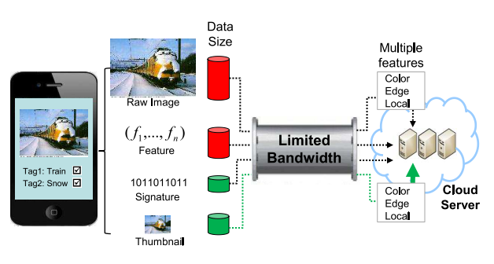
Introduction
System latency
Power Consumption
Figure1: a typical CS-based framework for mobile system

Slide 4
Motivation
Popularity of mobile devices, including smartphone, tablets, smartwatch, wearable health-monitoring devices
  Software facility, for example, easier access to internet
  Hardware improvement, for example, high resolution camera
Strict restriction on mobile devices, especially the power, computing ability and network bandwidth.
  Limited computing power
  Limited storage
  Limited network bandwidth
  Limited power/battery
Bright future of the emerging applications in mobile, leading research field and promising business opportunity.
  Big data analysis in health-monitoring devices, mobile multimedia system etc…
  Google Goggles, Amazon Snaptell

Slide 5
Related work
Bernd Girod et al, “mobile visual search”, gives an approach to this client-server based system and evaluation of its system latency, power consumption, especially the details about the system design
Yu-chuan su et al, “Enabling low bitrate mobile visual recognition – A performance versus Bandwidth Evaluation”, proposes a new terminology – “recognition bitrate” and gives evaluations of all the sub-process and comparison between the mainstream methods
Problem:
Most of the research focus only on improvement of one specific area, but can’t give an overall quantity evaluation of the system.
Multiple factors will affect latency and power consumption, their relationship is very complicated and sometimes co-related.

Slide 6
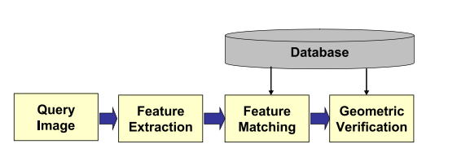
Proposed approach
Comparing global and local features with descriptor’s latency and power consumption.
  Global feature: color histogram, color moment, gabor etc.
  Local feature: Hessian Affine(HA), Difference of Gaussian(DoG) etc.
  Descriptor: Locality constraint linear coding(LLC), Vector of locally aggregated descriptor(VLAD)
  Open source software: OpenIMAJ, OpenCV, Vlfeat
Selecting features and classifier with better performance, then re-conducting experiment with different images, transferring different image will lead to different latency and power consumption, figure out the relation between accuracy and latency in different features.
Select best approach of deploying system, including feature selection, computing partitioning etc.
Refine some approach by combining
  multiple strategy.

Slide 7
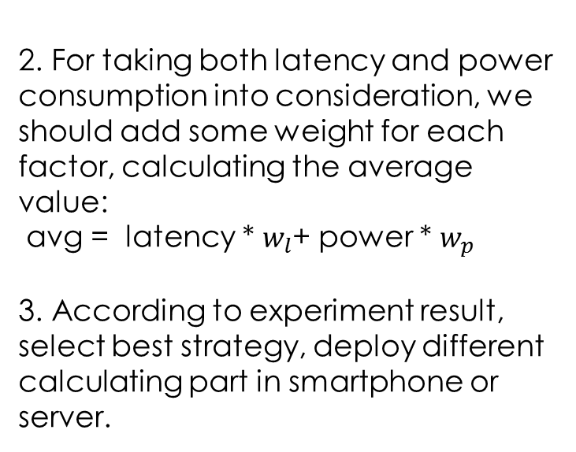
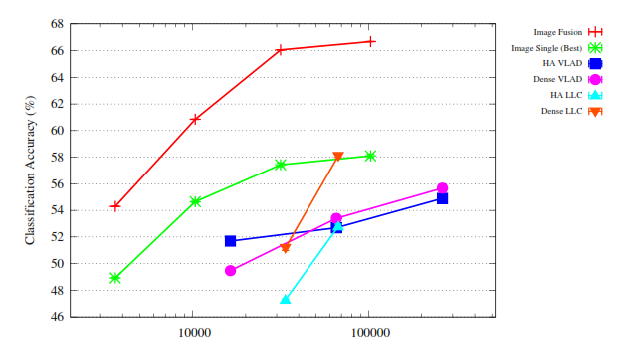
Proposed approach
For each strategy(feature, classifier), we could draw a line as below, showing the relationship between system latency and accuracy, power consumption and accuracy.
  X-ray indicate the factor we want to change, system latency or power consumption
  Y-ray indicate the determining standard for a system, for visual recognition, accuracy is most important.

Slide 8
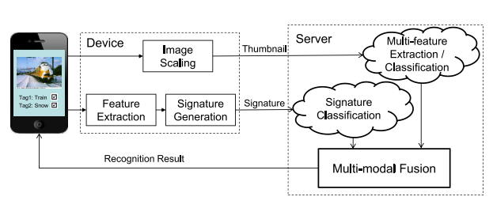
Proposed approach
System deployment:
Client: image scaling, feature extraction, signature generation
Server: multi-feature extraction/classification, multi-modal fusion
Deployment policy:
Computation intensity vs. wireless transmission.
  Computing on mobile is time-consuming and power-consuming,
  Computing in cloud server requires high bandwidth, while transmitting large data is also time-consuming and power-consuming.
Accuracy vs. optimization
  Reducing latency and power consumption will decrease accuracy in some degree.
  To what degree should we think an optimization is acceptable

Slide 9
Evaluation
Two criteria: system latency and power consumption
  System latency could be calculated by time, include:
    Local device computing time (varies in different features)
    Network transmitting time under the same bandwidth
    Server computing time(varies by different deployment)
  Power consumption is ONLY evaluated locally, cloud server’s consumption only differs little.
    PowerTutor: a power monitor for android-based mobile platforms
    Battery life Pro: monitor the system status for iOS devices.
Compare our strategy’s latency and consumption with traditional method respectively, evaluate the precision and correctness of the strategy.
Notes:
Joule, the SI unit of work or energy…

Slide 10
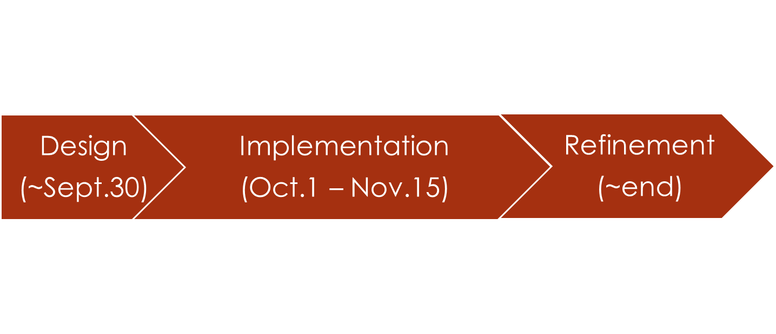
Timeline
Details:
Design: current ~ Sept.30^{th,} includes:
1. feature selection, comparison standard, evaluate tools
2. system architecture, platform tools and development language(for example, android and java …)
Implementation: Oct.1th ~ Nov.15th, includes: programming, experimenting etc…
Refinement: Nov.15th ~ Dec.10th, includes:
1. analyze the experiment result
2. summarize and make conclusion, writing paper etc…

